Slide 1
Droplet evaporation rate analysis on hot superhydrophobic surface

Slide 2
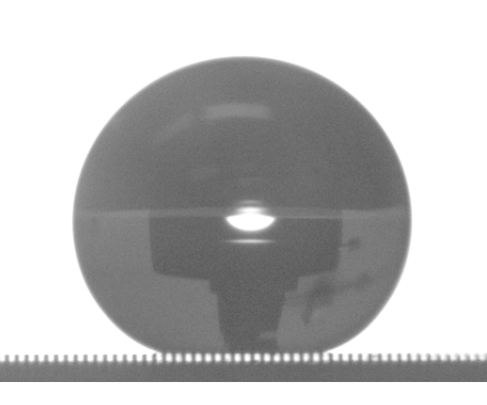
Snapshot of water droplet on substrate
0.6mm
It looks like Cassie state from side view point

Slide 3
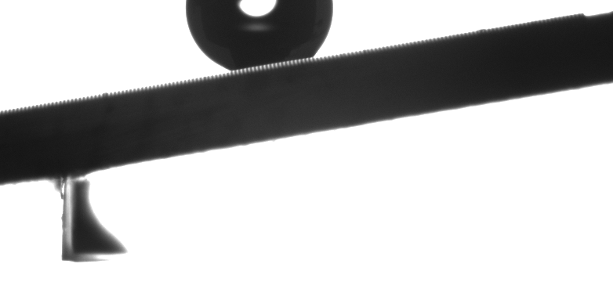
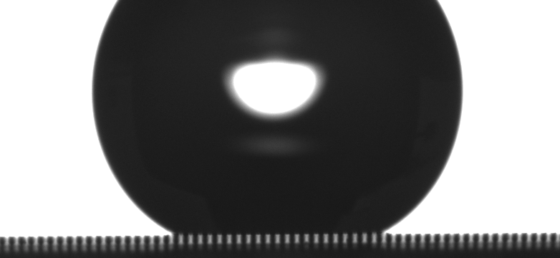
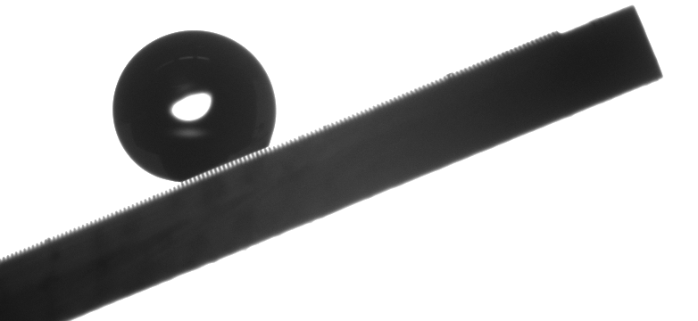

Large sliding angle

Slide 4
Energy balance during the evaporation process
Heat transfers from the hot substrate into the water droplet,
leading to the temperature increase of the water droplet. The heat is
released to the ambient by means of convection, radiation and evaporation.

Slide 5

Abdullah A, Berkir S, Haider A, Droplet Heat transfer on Micropost Arrays With Hydrophobic and Hydrophilic Characteristics. Journal of Heat Transfer. Vol. 140/ 072402-1.

Slide 6
Thermal resistance of the substrate
Thermal resistance of water vaper is much larger than all the others

Slide 7
Thermal constriction/spreading resistance
Thermal constriction resistance exists when heat flows from a large region into a narrower region.
Thermal spreading resistance exists when heat flows from a narrow region into a larger cross sectional area.

Slide 8
Water droplet evaporation

Slide 9
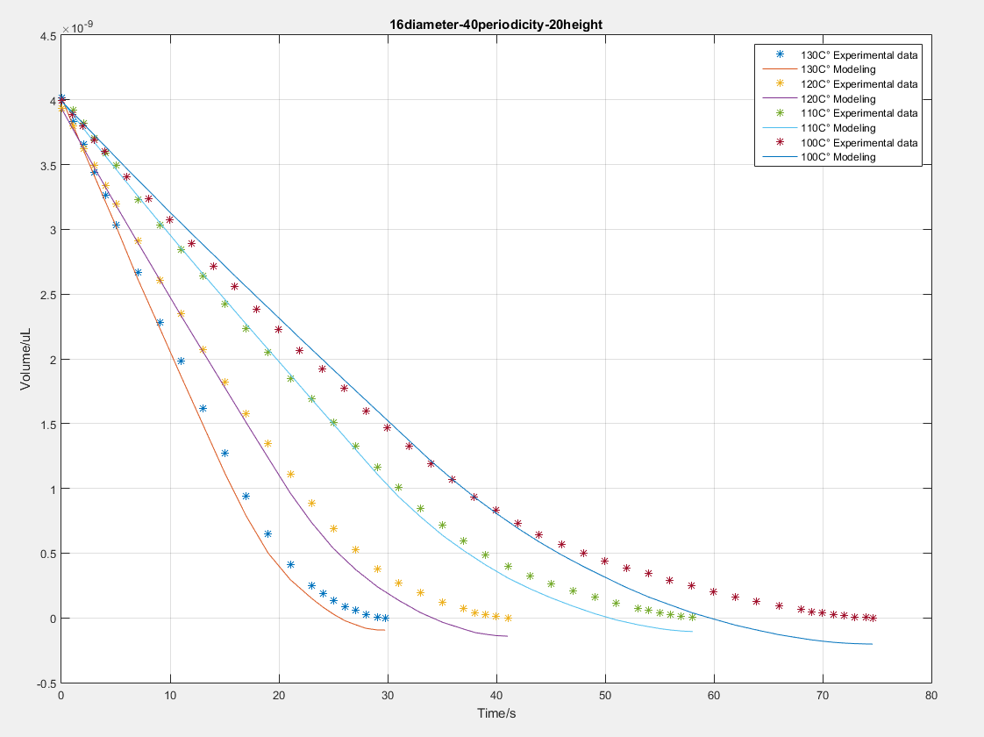
16um diameter 40um periodicity 20um micropillar height
100C° hot plate --- 89C° droplet
110C° hot plate --- 96C° droplet
120C° hot plate --- 100C° droplet
130C° hot plate --- 100C° droplet

Slide 10
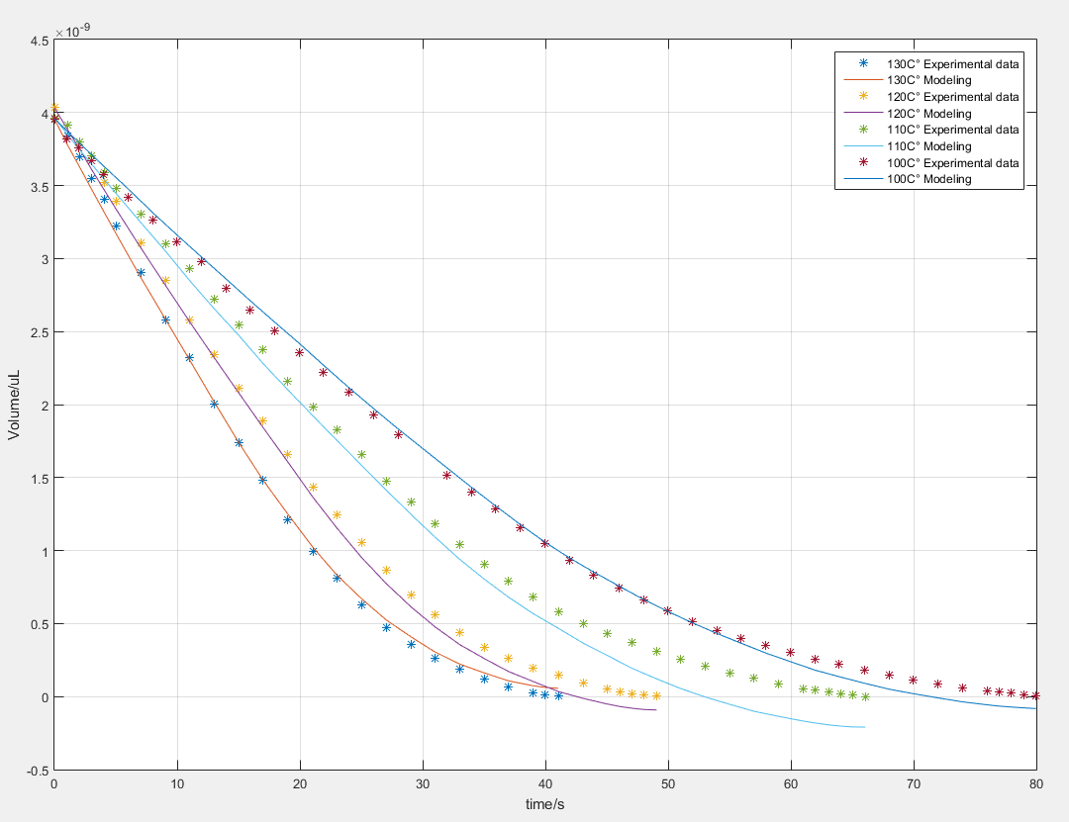
20um diameter 60um periodicity 40um micropillar height
100C° hot plate --- 80C° droplet
110C° hot plate --- 85C° droplet
120C° hot plate --- 90C° droplet
130C° hot plate --- 94C° droplet

Slide 11
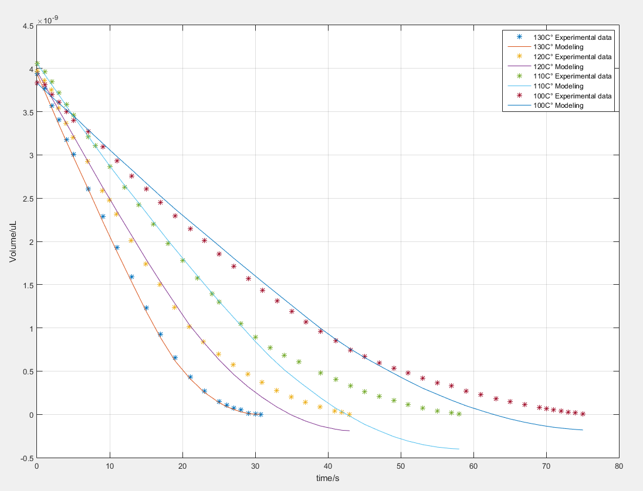
20um diameter 50um periodicity 20um micropillar height
100C° hot plate --- 87C° droplet
110C° hot plate --- 94C° droplet
120C° hot plate --- 100C° droplet
130C° hot plate --- 100C° droplet

Slide 12
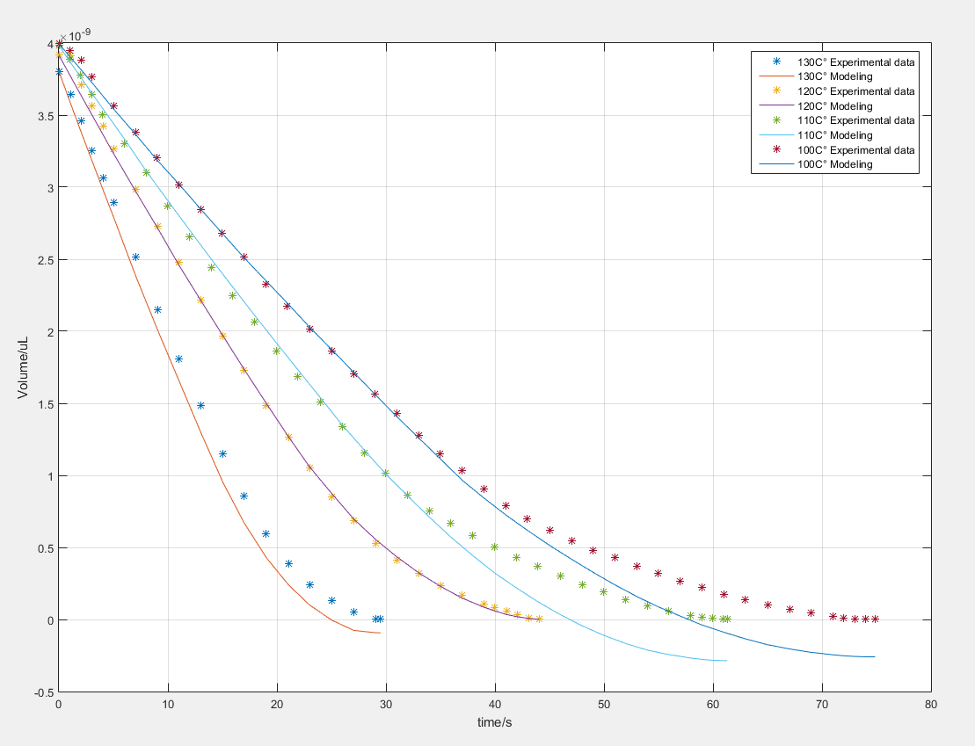
20um diameter 50um periodicity 40um micropillar height
100C° hot plate --- 87C° droplet
110C° hot plate --- 94C° droplet
120C° hot plate --- 100C° droplet
130C° hot plate --- 100C° droplet

Slide 13
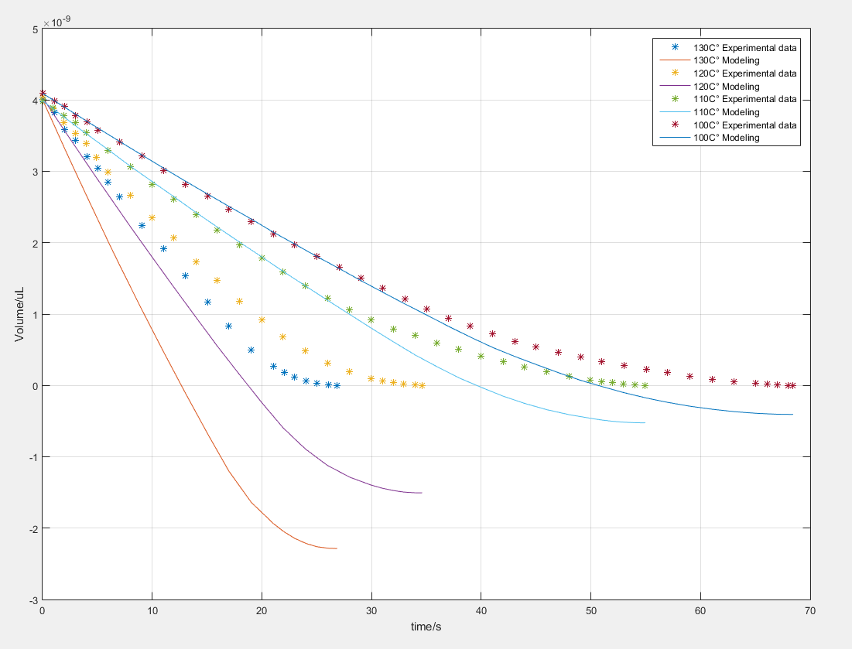
20um diameter 40um periodicity 40um micropillar height
100C° hot plate --- 92C° droplet
110C° hot plate --- 99C° droplet
120C° hot plate --- 100C° droplet
130C° hot plate --- 100C° droplet

Slide 14
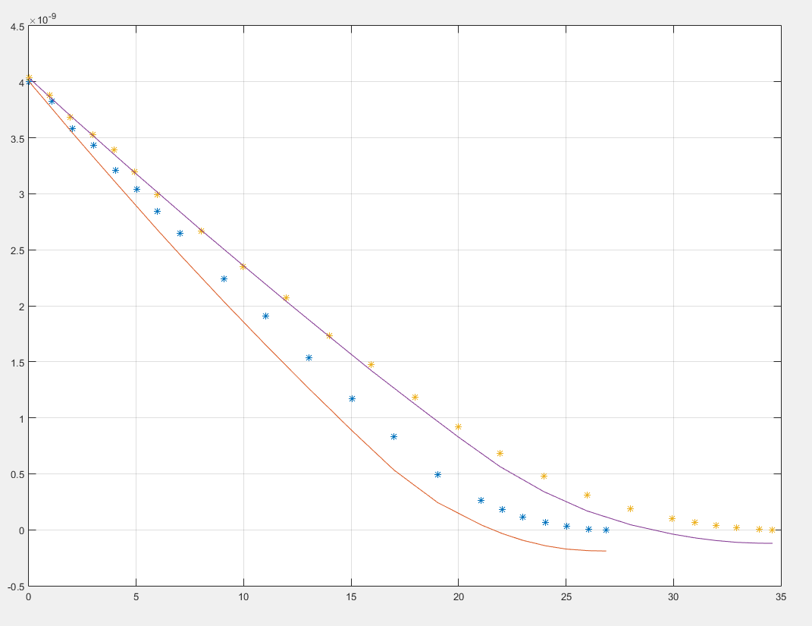
20um diameter 40um periodicity 40um micropillar height
120C° hot plate --- 105C° droplet
130C° hot plate --- 110C° droplet

Slide 15

Mask design
#1 20um diameter, 70um periodicity
1
2
3
#2 20um diameter, 80um periodicity
#3 20um diameter, 90um periodicity
#4 20um diameter, 100um periodicity
4
5
6
#5 20um diameter, 110um periodicity
#6 20um diameter, 120um periodicity
7
8
9
#7 16um diameter, 80um periodicity
#8 16um diameter, 100um periodicity
#9 16um diameter, 120um periodicity

Slide 16

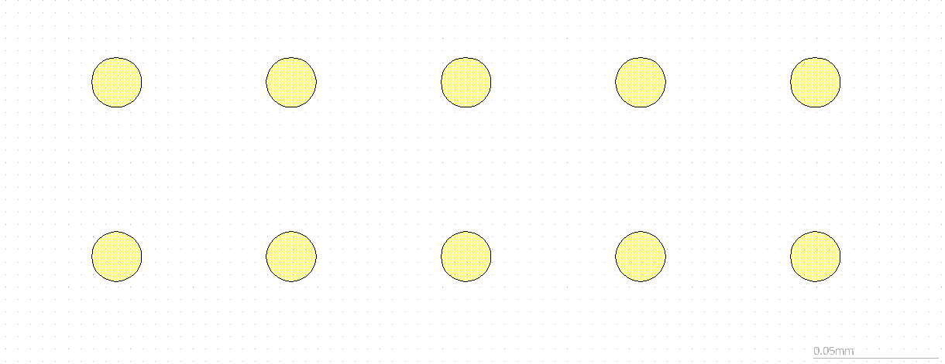
Mask design

Slide 17

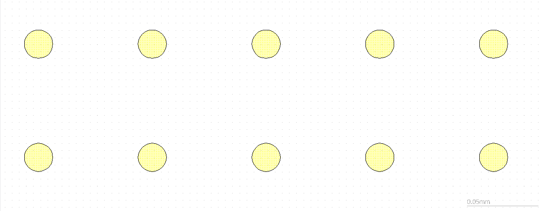
Mask design

Slide 18

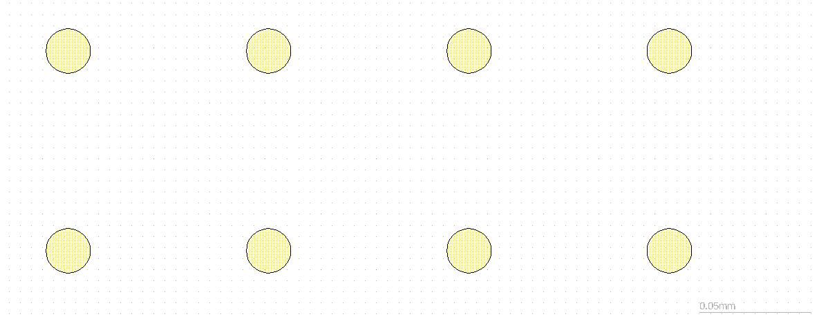
Mask design

Slide 19

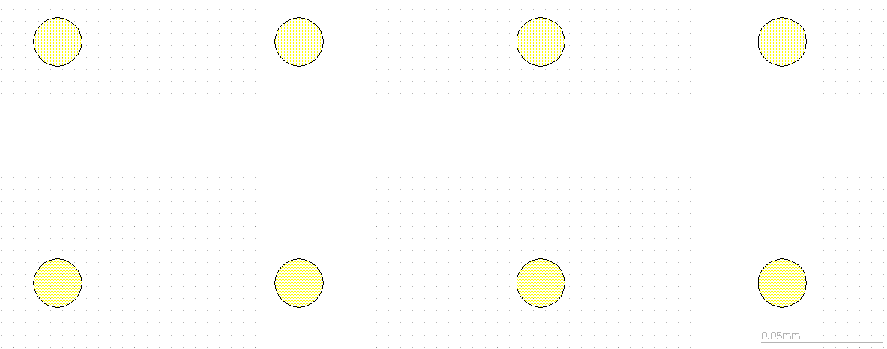
Mask design

Slide 20
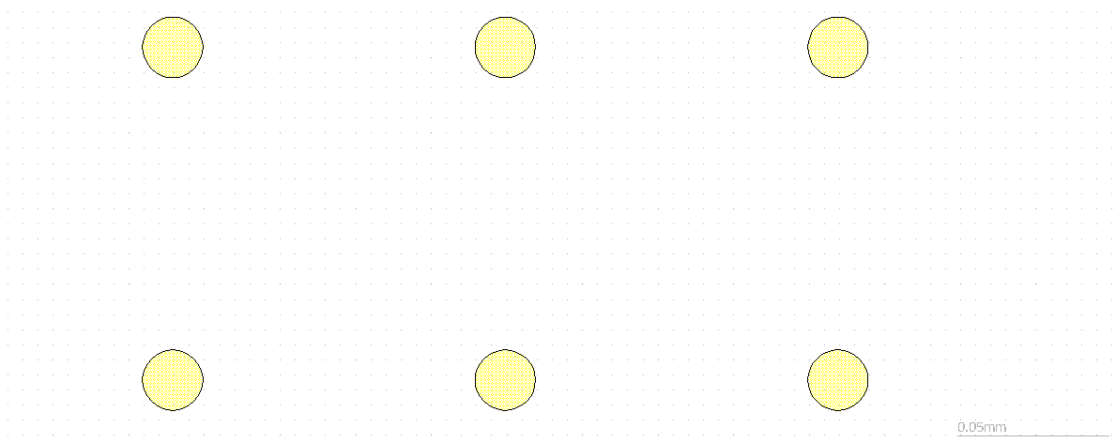

Mask design

Slide 21

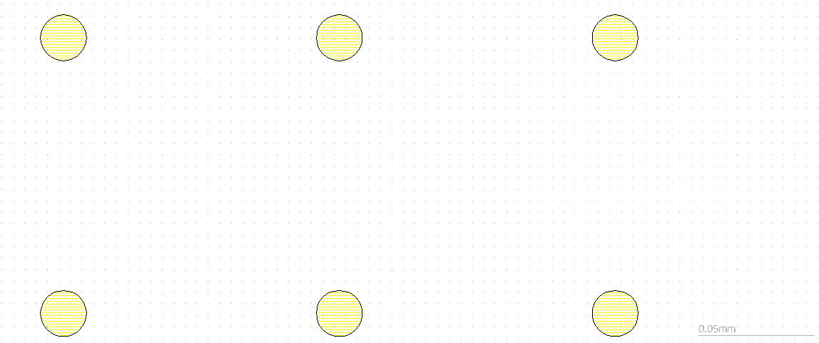
Mask design

Slide 22

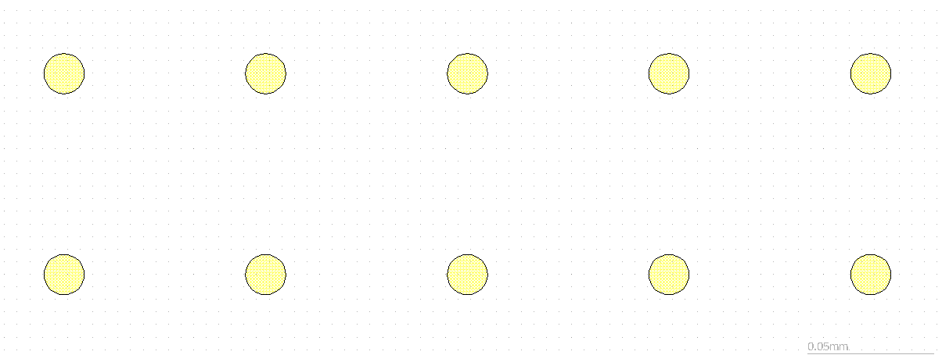
Mask design

Slide 23
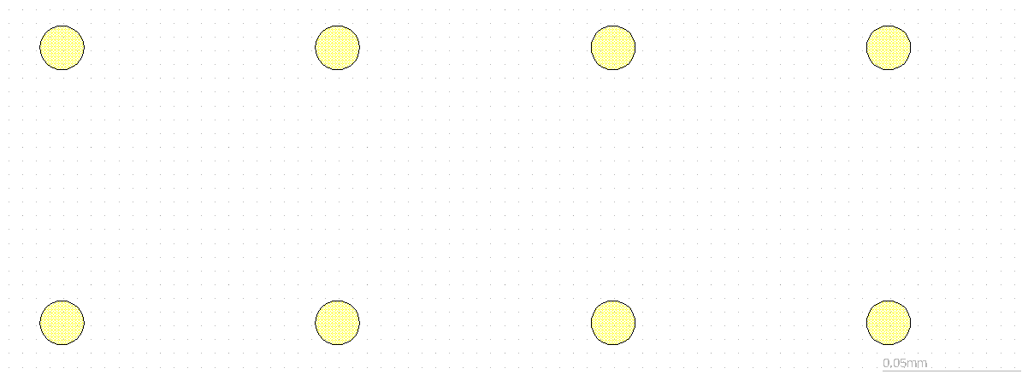
Mask design

Slide 24
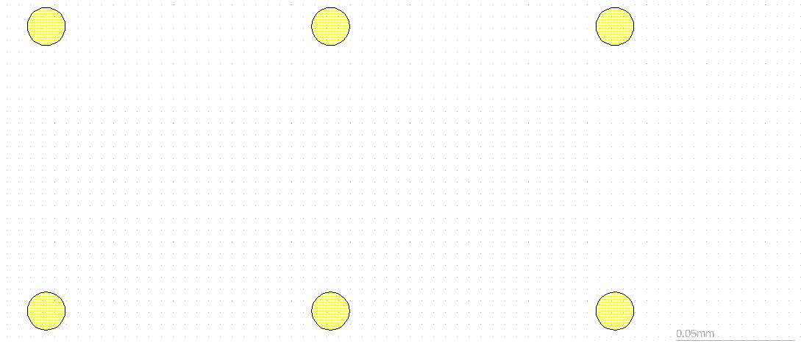
Mask design

Slide 25
Critical contact angle
Diameter (um) | Periodicity (um) | Critical CA with 40um height (°) | Critical CA with 20 um height (°)
20 | 30 | 100 | 108
20 | 40 | 109 | 120
20 | 50 | 117 | 129
20 | 60 | 124 | 136
20 | 70 | 130 | 141
20 | 80 | 135 | 146
20 | 90 | 139 | 149
20 | 100 | 142 | 152
20 | 110 | 145 | 154
20 | 120 | 148 | 156

